Slide 1
Comparing Speech Intelligibility with varying SNR, Reverb
Mezisashe Ojuba
21st June 2024.

Slide 2

Shifting Sound
Encountered same problem applying hamming window:
Original (CUNY Male): “Make sure you deposit that cheque”
No overlap
6ms
4ms
2ms
Notes:
m

Slide 3
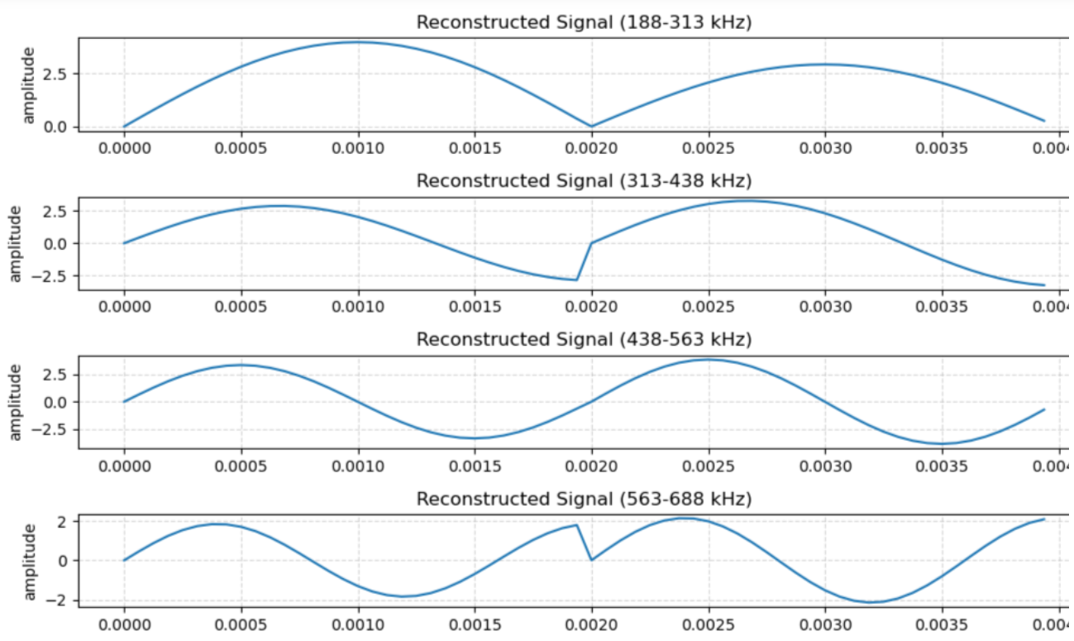
Applying Hamming Function before RMS

Slide 4
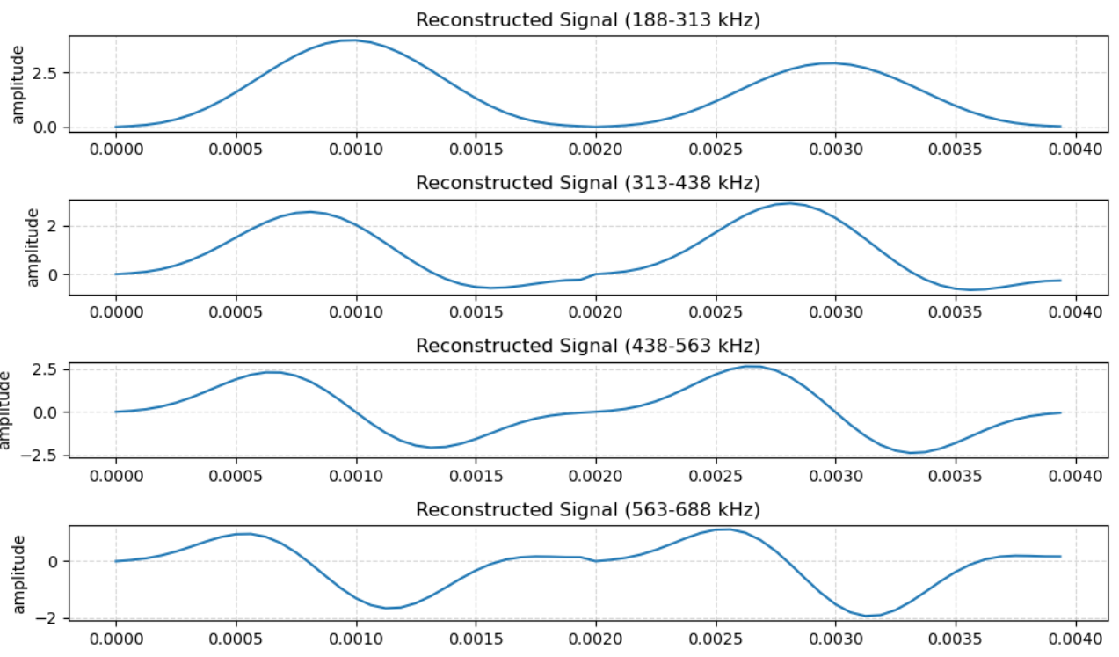
Applying Hamming Window to Signal
Presumably reduces spectral leakage, hence the plot of the signal looks so.
Yet, distorted sound.

Slide 5
Comparing Speech Intelligibility of Vocoded vs Non-Vocoded Sound
Notes:
Used stoi since i found quickly a simple python implementation

Slide 6
With Reverb
Added reverb to sound using pyroomacoustics to simulate a room audio with reverb
Ran the simulation
Original sound
With reverb (0.3 sec rt 60)
Notes:
I i

Slide 7
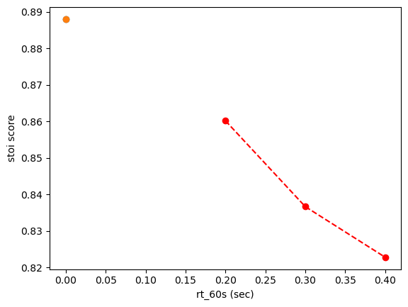
Stoi Scores
Notes:
Rt60 referring to the time it takes for reverb to fade into background noise. So the longer the reverb the lower the intelligibility

Slide 8
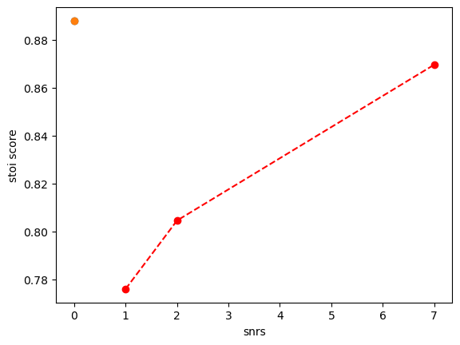
With SNR
Normalized sound using Pydub so all signals are the same power
Varied signal to sound ratio
Ran simulation cochlear implant
Notes:
Same procedure as last week

Slide 9
Other Tasks
Did literature review on speech enhancement algorithms, and mask estimation
Reorganizing code base into Batcave personal folder
Notes:
Have not looked into nucleus toolbox, next step
Have high level overview understanding
Yet to build

